Slide 1
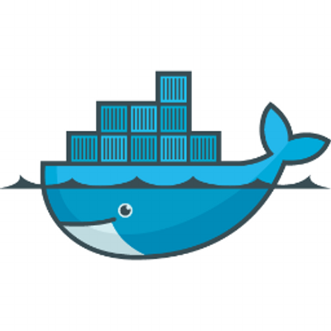

Docker 101
Containerizing applications and services
Presentation Date -16th March, 2015

Slide 2
Session Agendas
What is Docker?
Docker vs VM
Installing Docker
Building a Docker image
Running a Docker container

Slide 3
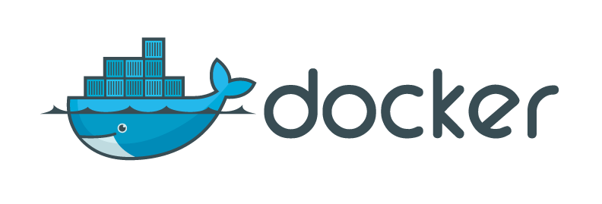
WHAT IS DOCKER?

Slide 4
It’s about containerization
Container
Think of it as a lightweight vm
No OS - Kernel
Has just enough binaries / libs to run required app/service
Own file system
Own network namespace – A container will have it’s own IP
Set limits for Memory, CPU
The Docker tools provide a great way to
Create Docker images (git - style)
Run containers based on images
Orchestrate containers (New)
Limitation: - Linux Only

Slide 5
Docker Containers vs VM

Slide 6
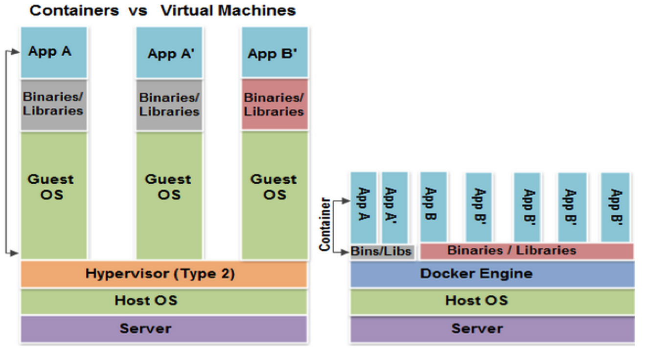

Slide 7
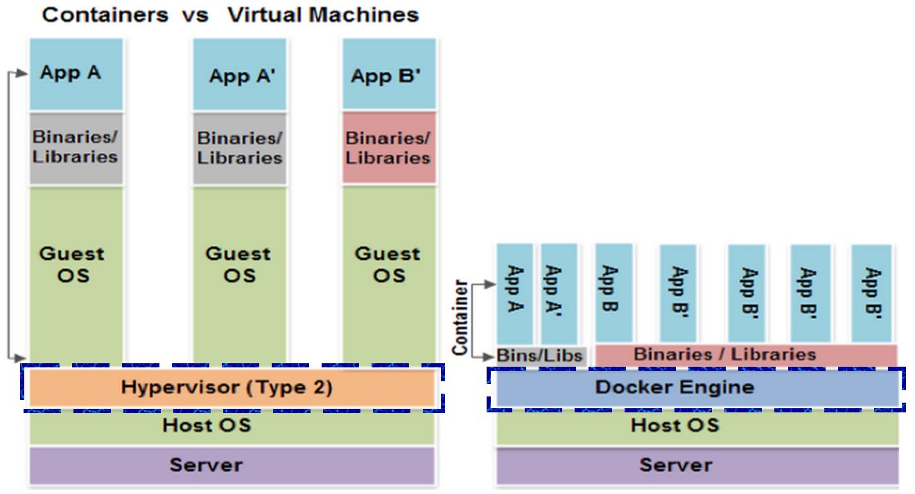

Slide 8
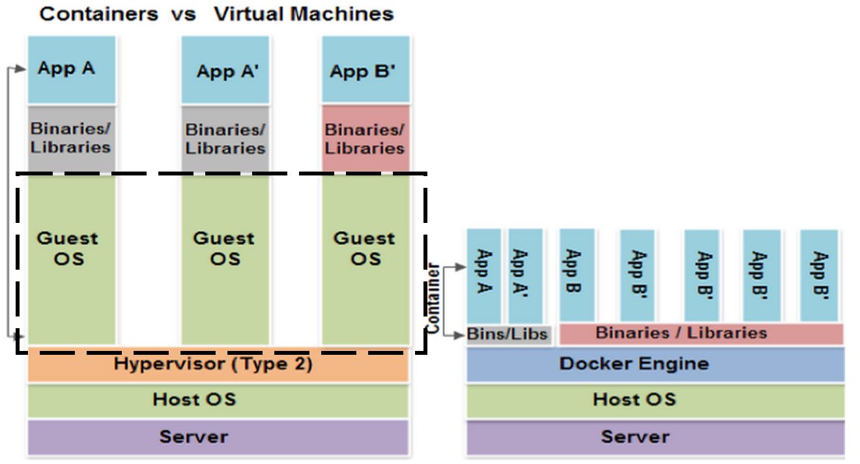

Slide 9
Read more about Docker Container vs VM here

Slide 10
Docker - Components
Docker Engine / Daemon
Runs on a Host
Can spin up Docker containers
Docker Client
Used to instruct the Docker Engine
Docker images & containers
Docker image – based on Union File System
Shareable
Docker container – An Docker image in running state
“So you build an image and run a container off of it”
Docker Registry
Like a git-repo for Docker images
Docker daemon talks to Registry to pull/push images

Slide 11
Docker Setup on Linux

Slide 12
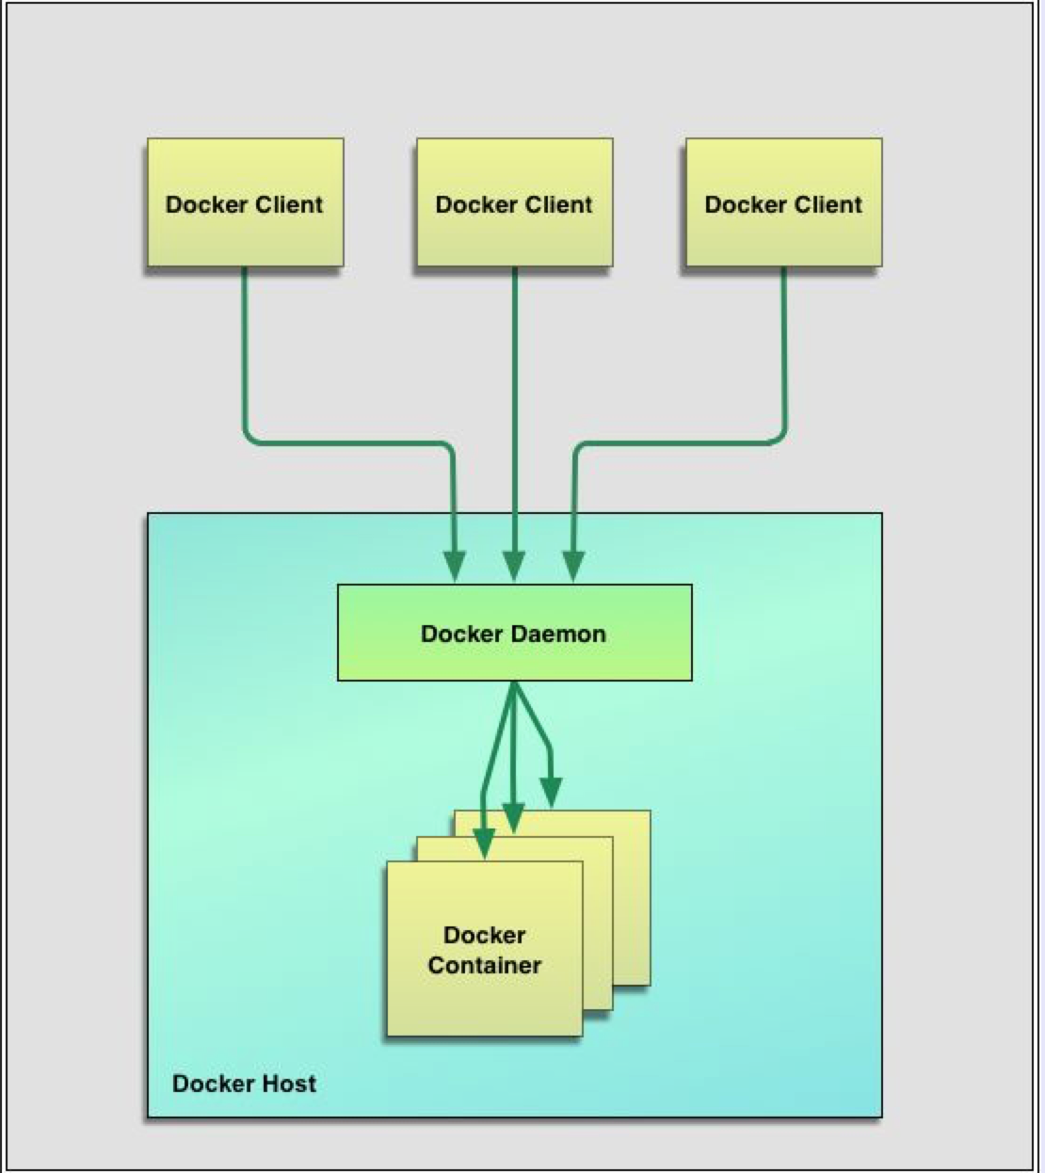

Slide 13
Docker Setup on Mac

Slide 14
Download and Install Virtual Box from link:VirtualBox
Since Docker works with Linux Kernel, we need to install boot2Docker which provides Linux Kernel for Containers to be created on it. link:boot2Docker
After installing the above package, restart the mac machine.
After the machine restarts, search for boot2Docker in Launchpad and Launch it. (It does everything for us). You can see a new instance(boot2docker-vm) created on Virtual Box.

Slide 15
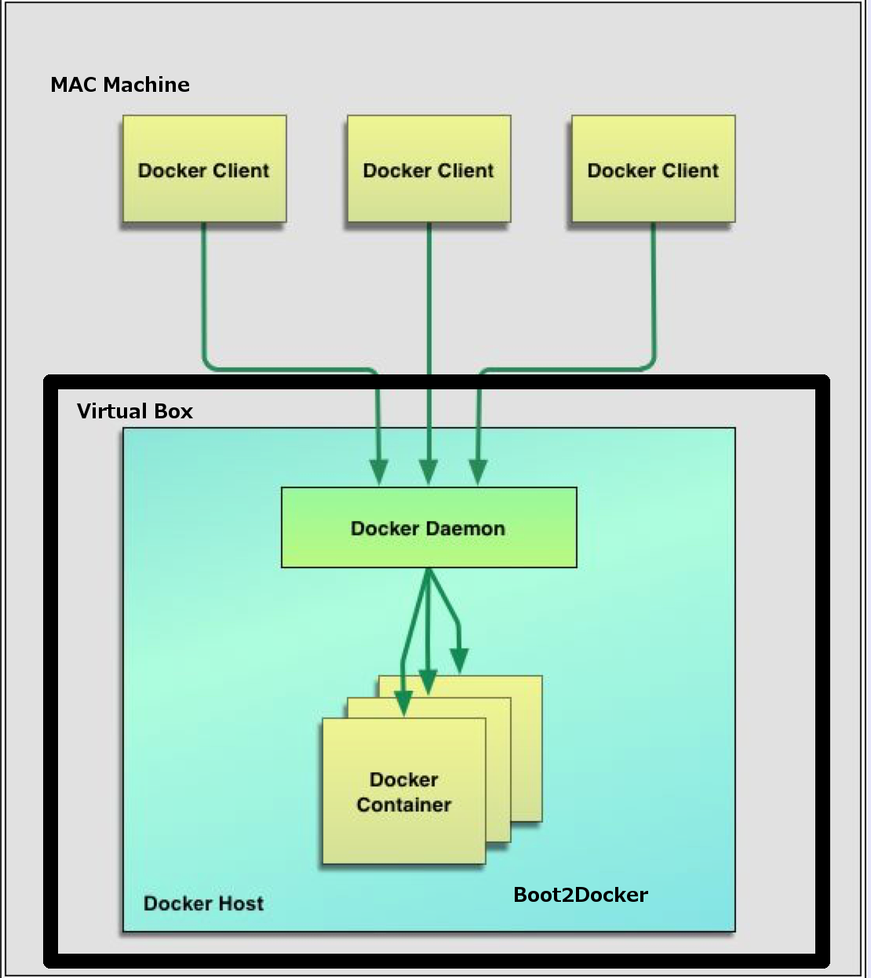

Slide 16
Building Docker Image and running Docker Container - Demo

Slide 17
Demo
Building a Docker image that has Apache Web Server on it
Using Dockerfile
Running the Docker container based on above image
PS: Code demonstrated here can be found at GIT-Hub - https://github.com/zakeeruddin21/Docker-101

Slide 18
Few useful Docker Commands

Slide 19
We need images to build our containers
$ docker pull ubuntu:14.04
Get the details of images downloaded
$ docker images
Create an ubuntu container
$ docker run –i –t ubunut:latest /bin/bash
To see the running containers
$ docker ps
To fetch all containers (running and stopped)
$ docker ps -a

Slide 20
To stop the running container
$ docker stop <container_id/name>
To start the running container
$ docker restart <container-id/name>
If the container was originally launched with interactive option then do the following also
$ docker attach <container-id>
There are many more commands that can be found at link:Docker-commands

Slide 21
References
Zakeer’s Github link: https://github.com/zakeeruddin21/Docker-101
Docker official website : https://docs.docker.com/
The Docker Book - Containerization is the new virtualization by James Turnbull
Docker blog - https://blog.docker.com
Docker Installation on Mac – youtube
Brief introduction to Docker Virtualization - youtube

